Slide 1

Functional Spark
CUSTOMER SENTIMENT ANALYSIS
Team #7
Nadkar, Kailash
Patodi, Abhi

Slide 2
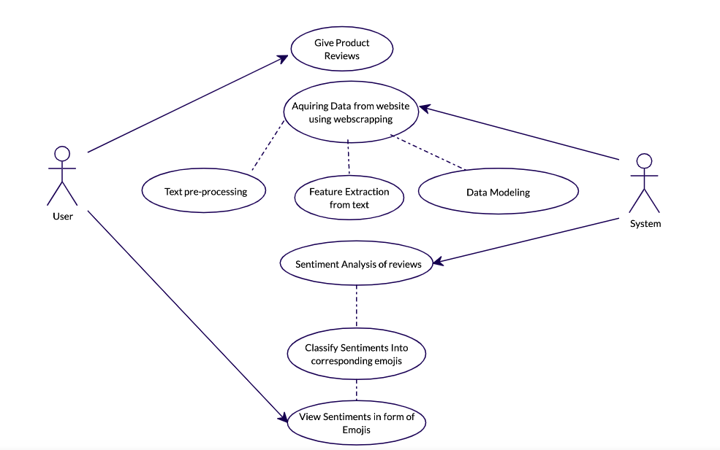

GENERAL USE CASE

Slide 3



Development FLOW
Scrapping Data
Data Cleaning
Data Modeling
Visualization
Website
Customer Review
Scrapping Data using AKKA and JSoup
Load and Clean Data using Apache Spark
Modeled the acquired data using:
(Apache Spark ML Pipeline)
1. SVM
2. Logistic Regression
3. Decision Tree
4. Naïve Bayes
Visualized Data using Zeppelin
Website for emoji representation using:
HTML, CSS and Flask server

Slide 4

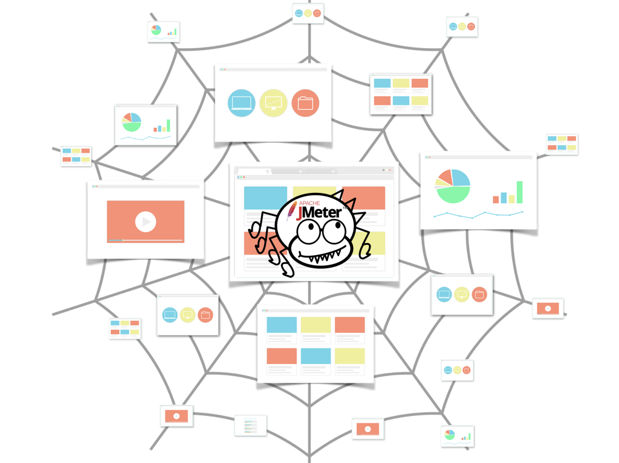
WEB Crawler & SCRAPPER
Assumptions:
We will base our web crawler on several conditions:
Web crawler must not spam websites, so each request to a single website should be delayed.
All operations must be non-blocking.
We assume that the web connection is not good, so the crawler might fail sometimes. In such a case the system must recover in the face of failure.
Since we will be running the crawler on a regular computer, then we need to stop the system when we scrap enough links. The check itself will be regulated by a simple threshold value.

Slide 5
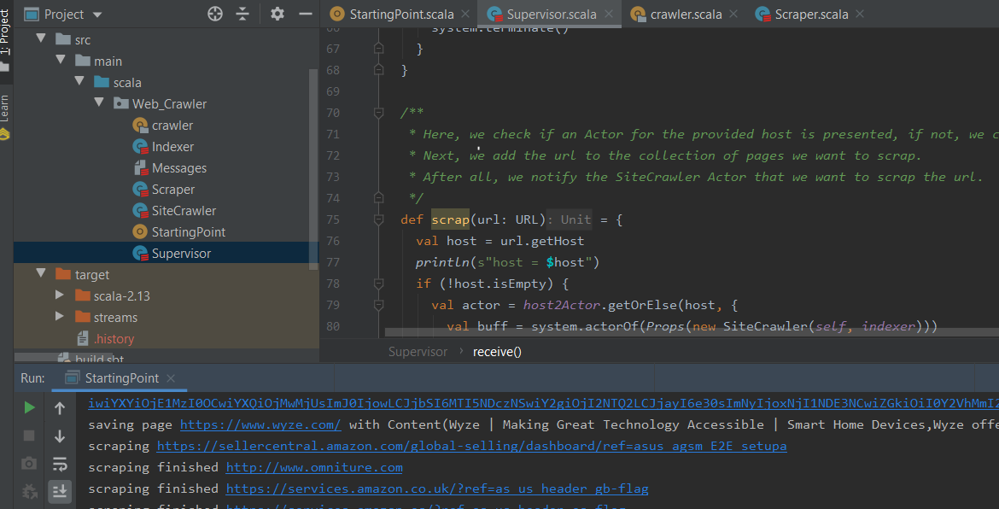
WEB Crawler CODE STRUCTURE

Slide 6
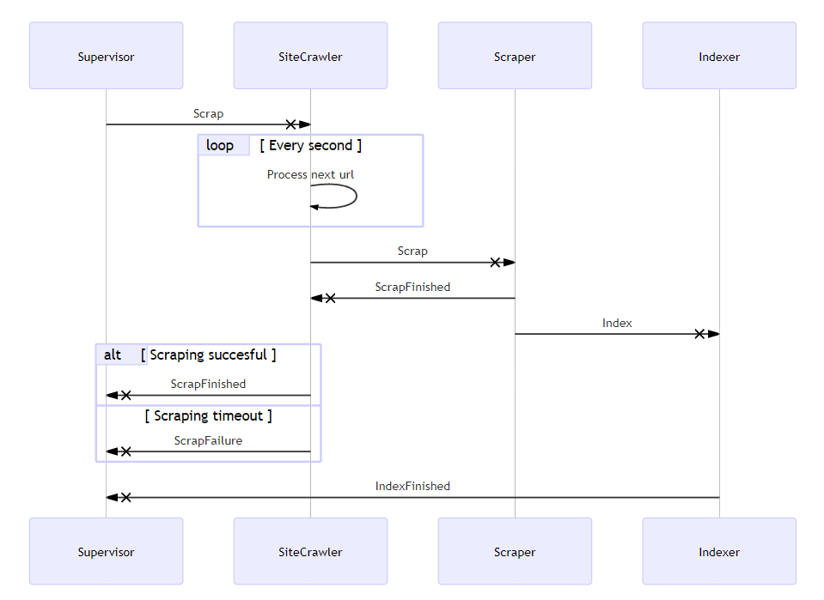
AKKA
Flow
DIAGRAM

Slide 7
Workflow of Crawler:
1. Starting Point
The App class of the project do several things, such as:
2. Supervisor
The Supervisor has four basic variables:
creating the main Actor and initializing it with a first website we want to process,
stopping the whole system if the process was not ended yet.
How many pages we visited (sent for scraping).
How many times we tried to visit a particular page. This is needed, since we think that scraping might fail and in that case we need to visit a page several times.
Store for Site Crawler Actors for each host we need to deal with.
Which pages we still need to scrap.
we check if an Actor for the provided host is presented, if not, we create it and add to our host2Actor container. Next, we add the URL to the collection of pages we want to scrap. After all, we notify the Site Crawler Actor that we want to scrap the URL.
The receive function body of Supervisor class contains a handler for each received message. Each message is a case class. To see all messages, check the Messages class in the project repository.
When the Indexer finishes its processing, it sends the url information to the Supervisor using IndexFinished message.

Slide 8
Workflow of Crawler:
3. Site Crawler
We create an instance of Site Crawler for each website (host) in the Supervisor Actor as we saw previously. In that case we need to deal with only one website and do not worry about synchronizations with the others.
4. Scraper
The Scrapper Actor is simple. It does not contain any state (so we could use a simple Future instead of an Actor) and its purpose is to scrap the provided URL and send the success flag to the sender and the scraped information to the Indexer.
We create a scheduler that sends a process message to the Actor each second. We cannot call the internal process directly, since there is no synchronization between it and the Site Crawler Actor. Without the scheduler it might be possible that we modify to Process variable in two places at the same time: when we add a new URL to that variable (Scrap message) and when we remove the last added element from the list (process message).
When we need to get a response from an Actor, we can use the ask pattern. It uses a ? symbol. The timeout variable implicitly defines how much time we wait before the ask fails automatically. And if it does, the process recovers with the Scrap Failure message. Finally, we send the status back to the Supervisor.

Slide 9

SENTIMENT ANALYIS Code Overview

Slide 10

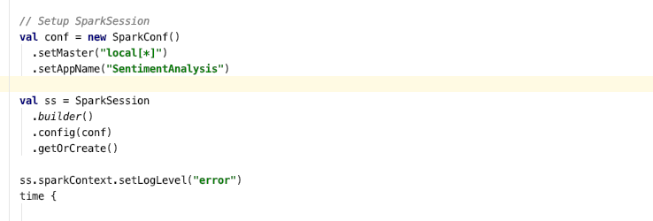
SPARK SETUP

Slide 11
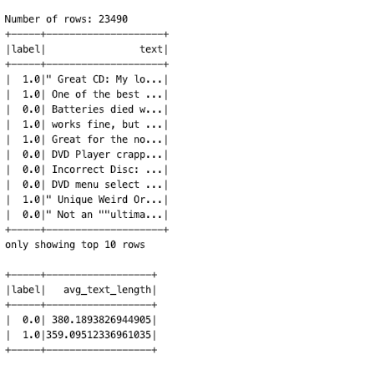
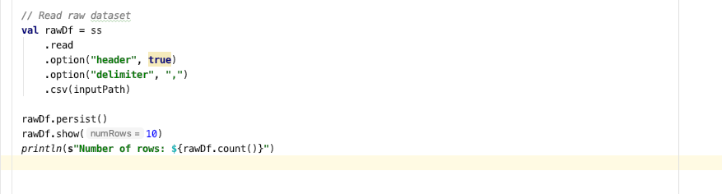
Training Dataset

Slide 12
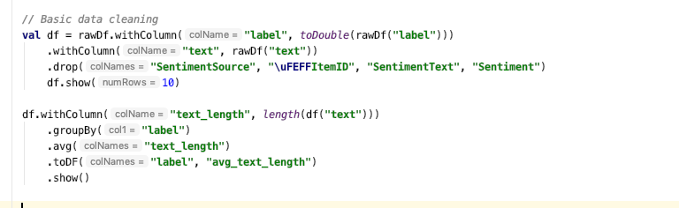

Cleaning and Splitting Data

Slide 13
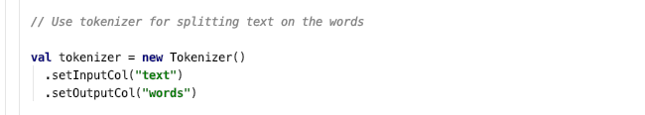
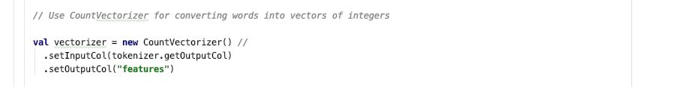
Tokenization and Count Vectorizer

Slide 14
Data Modeling

Slide 15
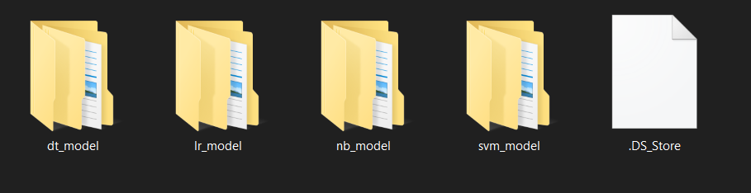
Storing Model

Slide 16
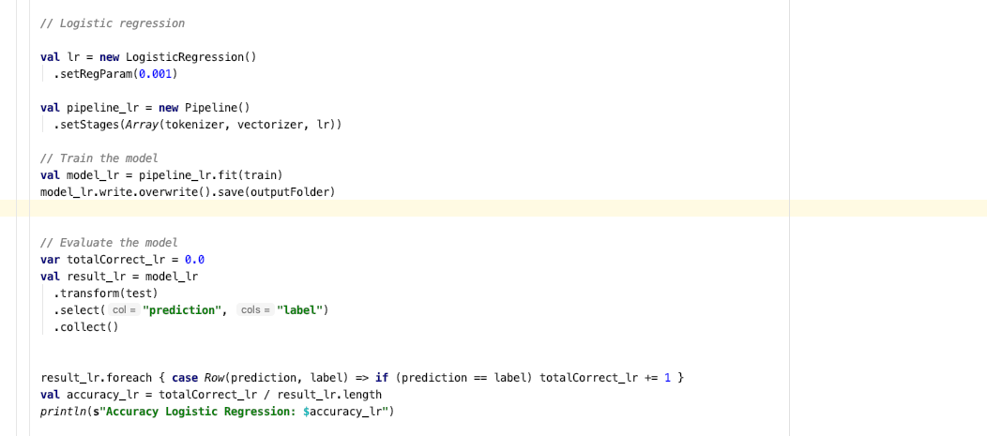

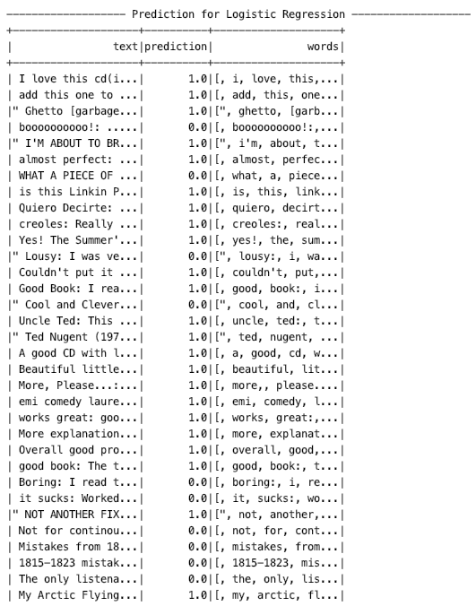
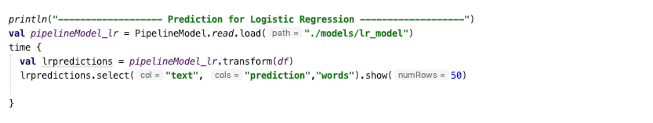
LOGISTIC REGRESSION

Slide 17
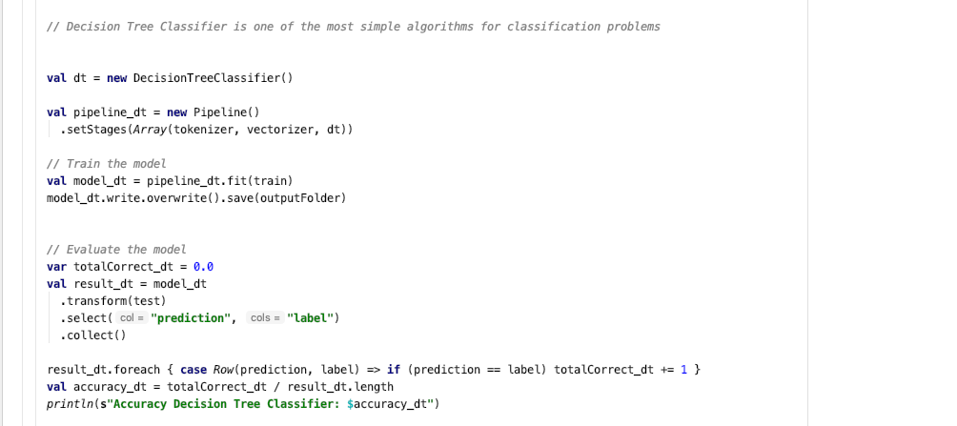

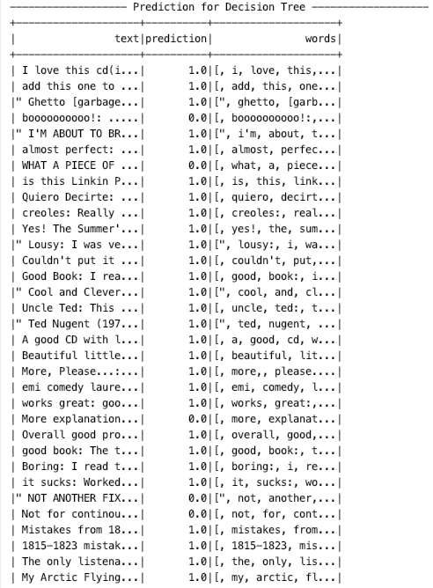
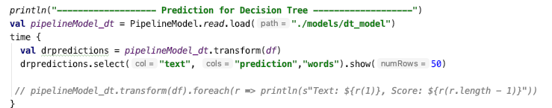
Decision Tree

Slide 18
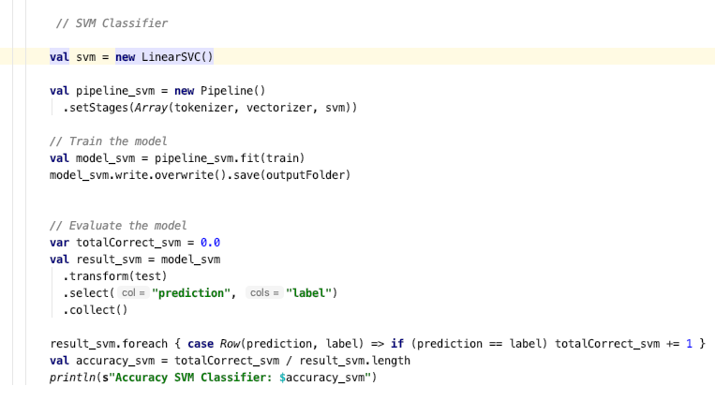

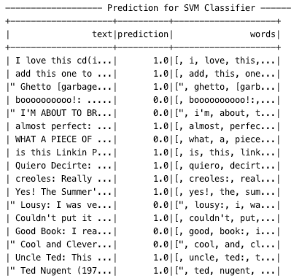
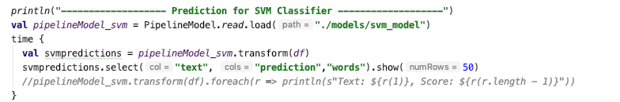
Support Vector Machine

Slide 19
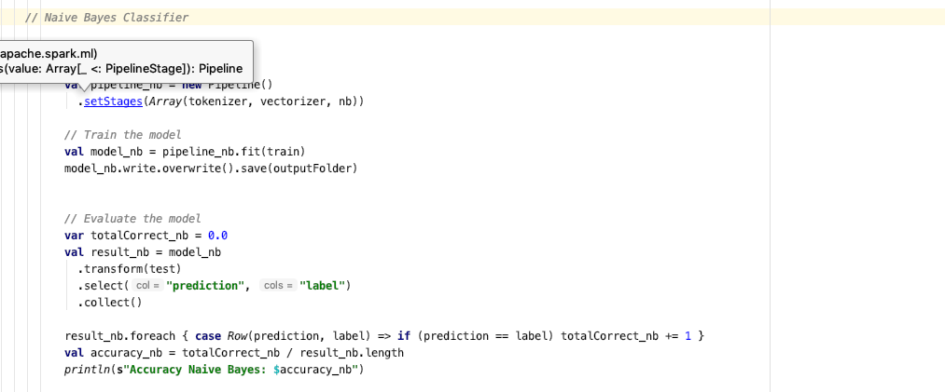

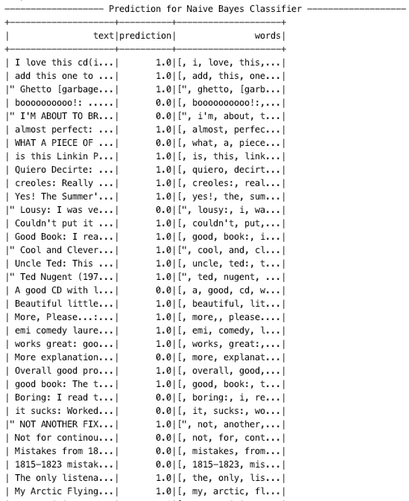
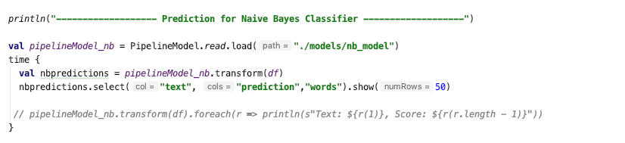
Naïve Bayes Classifier

Slide 20
Visualization

Slide 21
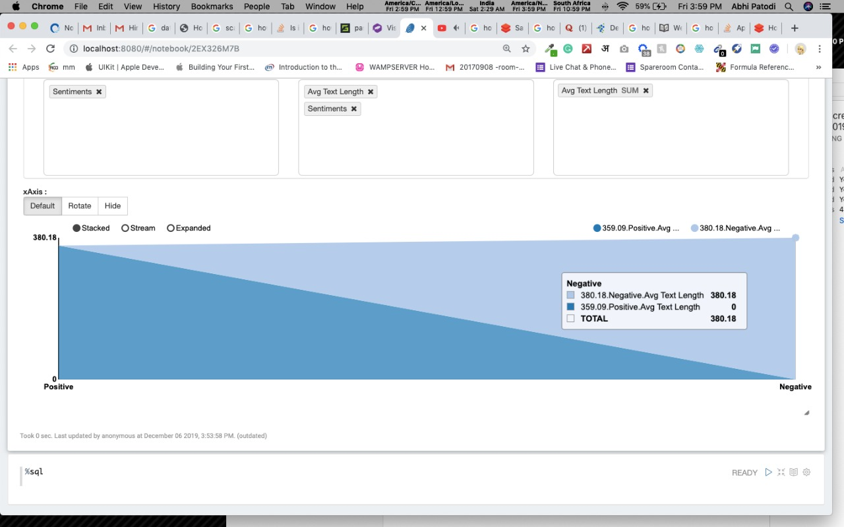
Dataset positive and negative review average word count:

Slide 22
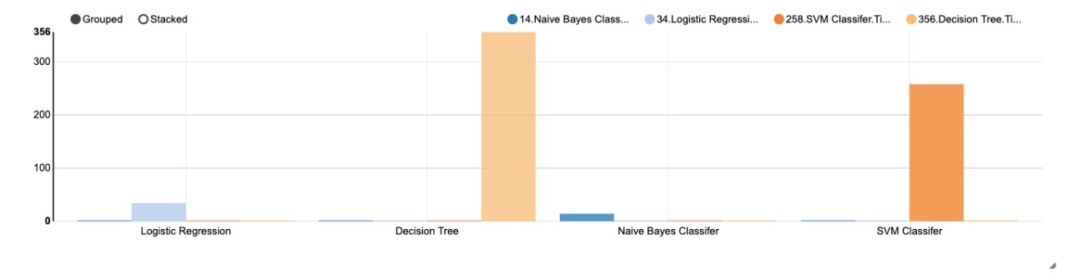
Execution Time of Models

Slide 23
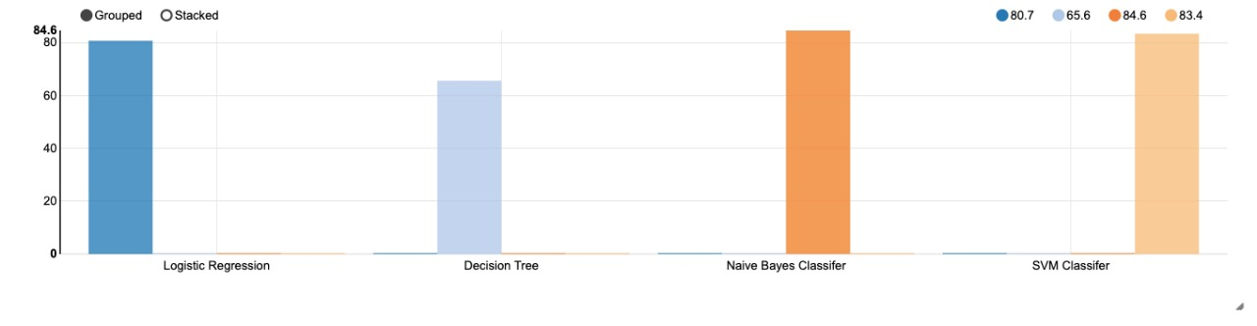
Accuracy of Models

Slide 24


Website

Slide 25
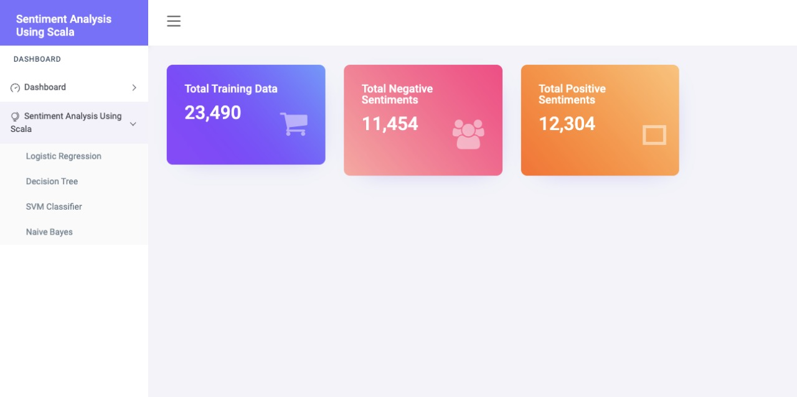
Dashboard

Slide 26
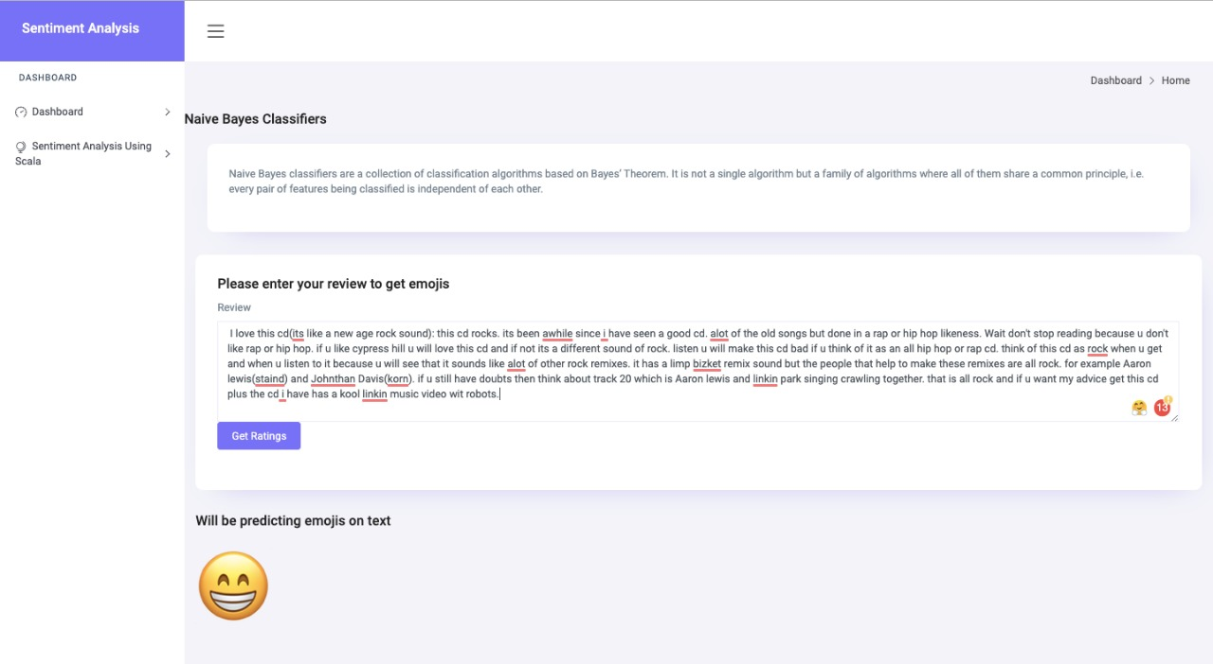
Model Based Representation: Positive

Slide 27
Model Based Representation: NEGATIVE

Slide 28
Model Based Representation: NEGATIVE

Slide 29
Acceptance Criteria
Training data must contain 10,000+ reviews
Training Data must be split into Train-Test (80% - 20%) for validation
At least 1 model should have runtime less than 20 seconds
Out of 4 models at least one model should achieve accuracy more than 80%
Following are our achieved acceptance criteria
Model must be tested on 1000+ unlabeled reviews
Model | Accuracy Score | Time for Training
Logistic Regression | 80.7 | 34 sec
Naïve Bayes | 84.6 | 14 sec
Decision Tree | 65.6 | 356 sec
Support Vector Machine | 83.4 | 258 sec

Slide 30
Project Milestones
Presentation
GitHub Repo Setup
Start
11/8
11/11
11/14
Designing AKKA & JSOUP
Cleaning & Filtering Data
Web Scrapping
11/22
11/18
11/24
Sentiment Analysis
Representation of Emojis
Visualization
Final Presentation
11/28
12/06
12/02

Slide 31



program in Scala and repository
Web Scrapping: AKKA and JSoup
Data Cleaning & Modelling Using Spark ML Libraries
Sentiment Analysis using: Naive Bayes and GBM
Validation & Visualization:
Zeppelin
Code repository:
https://github.com/KailashDN/FunctionalSpark

Slide 32
Goals
Sentiment Analysis can uncover customer attitudes on products reviews and detect their tone on words and categorize them as either positive, negative or neutral
Our goal is to make this sentiments of customer toward product more easily readable, understandable to E-Commerce organization.
It will help shape the business more toward the customer interest and make improvement in business approaches,

Slide 33
Future Scope
Make Sentiment Representation in emoji Real time.
For example:
If customer writes a review, The sentiment of Review can be shown immediately below textbox
Can be use in Messenger, Chatting App to immediately see the sentiment of your text before sending to your peer.

Slide 34


